Slide 1


CMS ttX Round-table Status Report National Technical University of Athens
G. Bakas, K. Kousouris, I. Papakrivopoulos, G. Tsipolitis

Slide 2

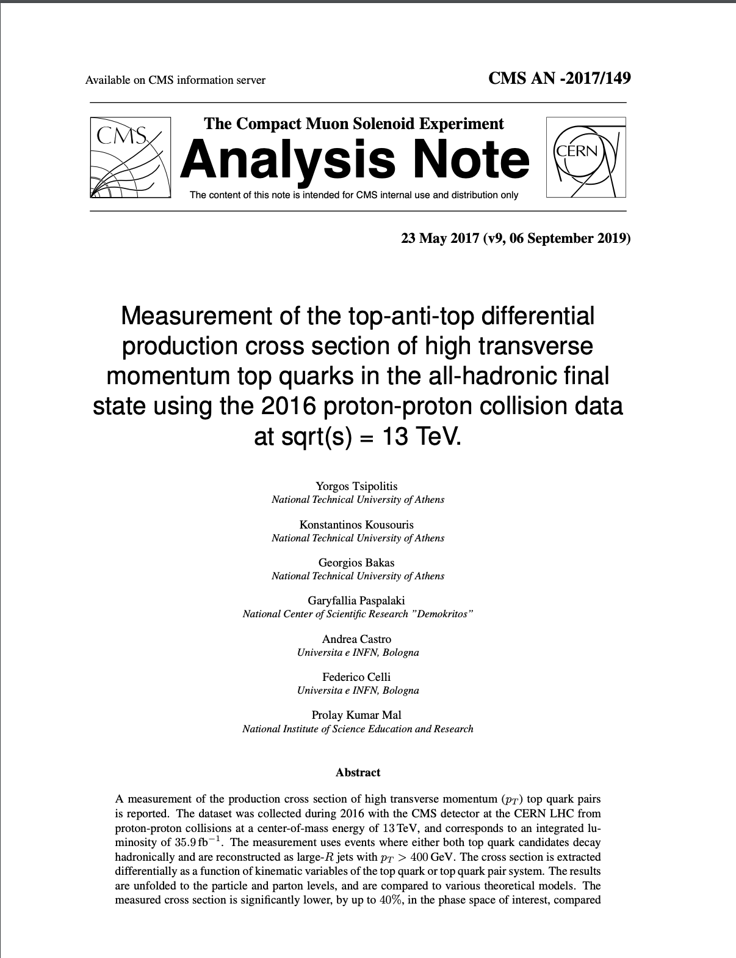
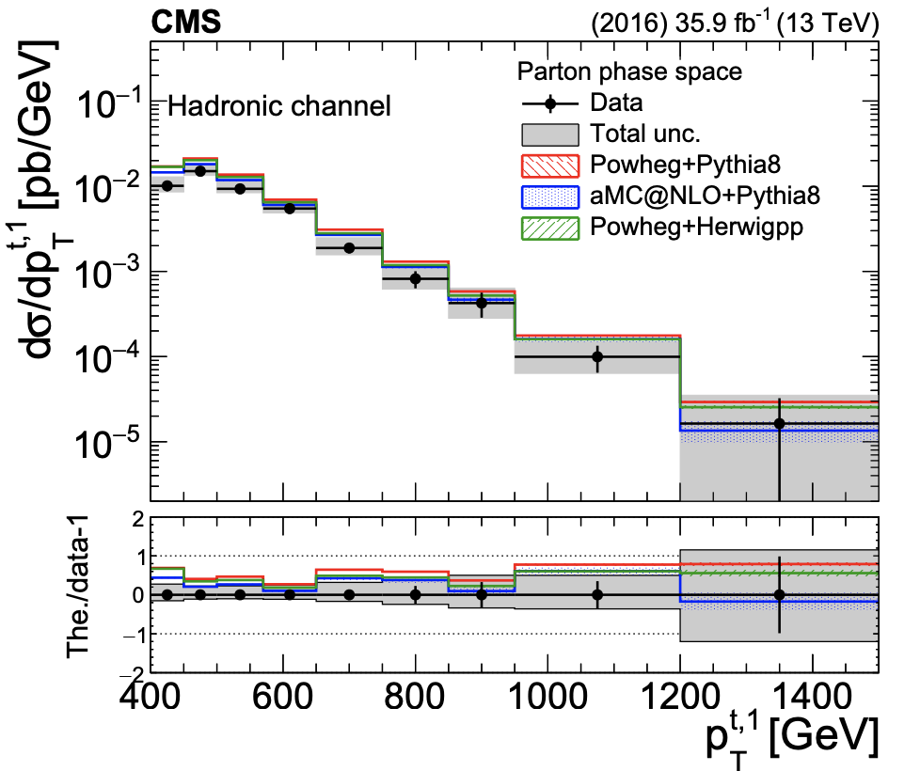
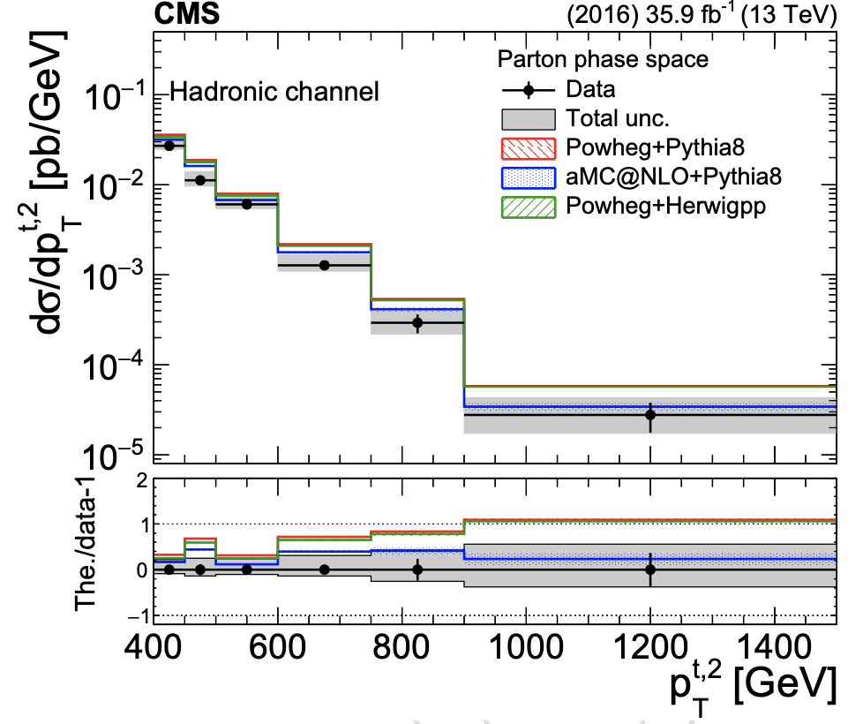
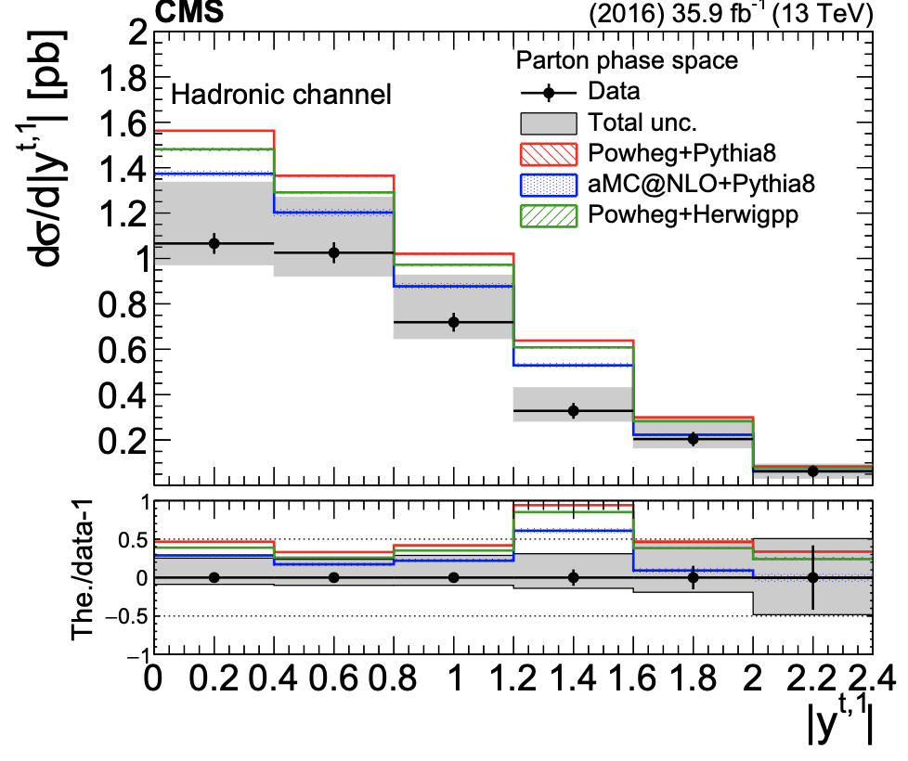
Status 2016 Analysis
ttbar differential cross sections in boosted l+jets and all-hadronic channel (2016)
TOP-18-013 and AN-2017/149
ARC authors meeting: decided that two investigated variables should change
No inclusive jet P_{T} and jet Eta
Now: leading jet P_{T} and absolute value of leading jet rapidity
Sub-leading jet P_{T} and absolute value of sub-leading jet rapidity
Consistent with the semi-leptonic analysis
Changes have been already implemented there are new versions both for AN and paper
TOP-18-013
AN-2017/149

Slide 3
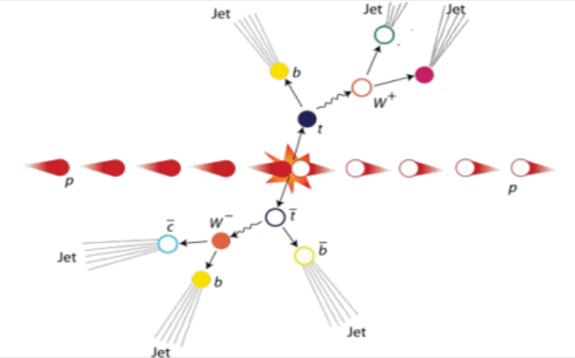
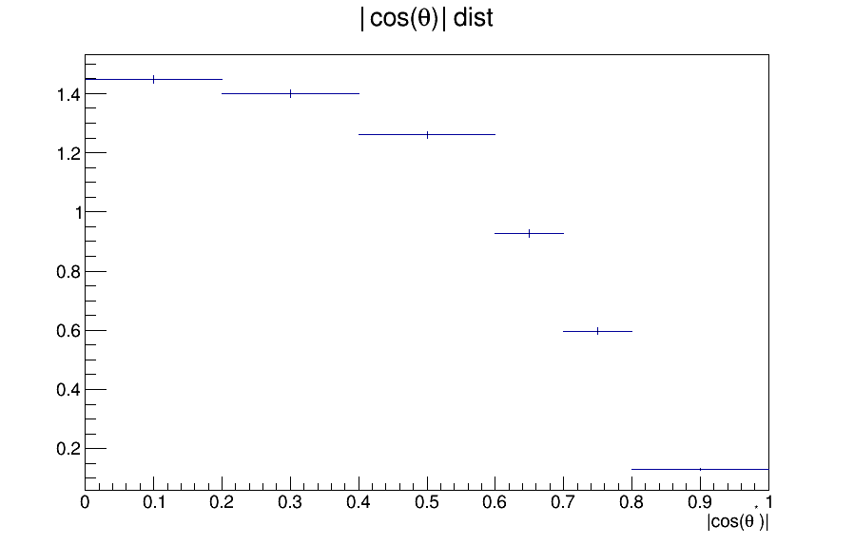
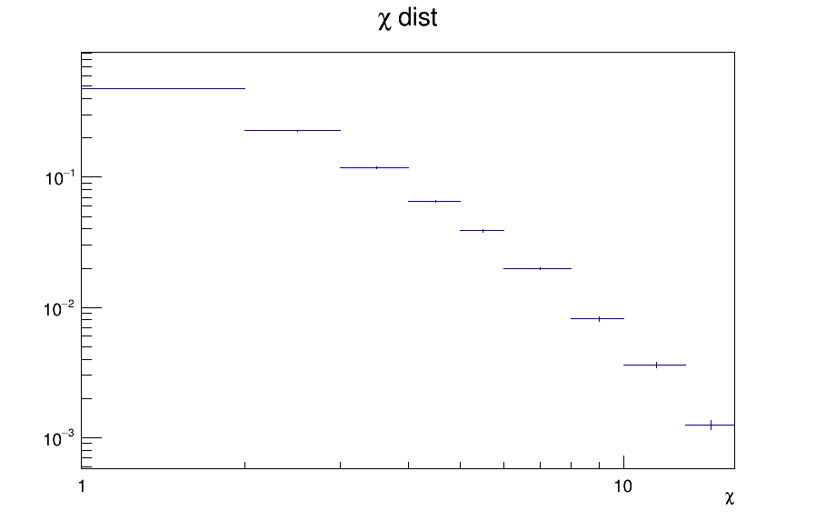

Status full RunII Data
Final State/Decay Channel: Fully hadronic final state
Boosted ttbar analysis (P_{T} > 400 GeV)
Differential Cross section in different phase spaces for various variables
Fiducial and then unfolded to Particle and Parton phase space
ttbar system mass, P_{T} and rapidity (y)
Leading jet P_{T} and absolute leading jet rapidity (|y|)
Sub-leading jet P_{T} and absolute sub-leading jet rapidity (|y|)
|cos(θ*)|: where scattering angle θ* is the angle between top quark and z-axis in the Zero Momentum Frame
χ: where $χ=e^{{|2y}^{∗}|}=e^{|y_{1}−y_{2}|}$ and y₁ and y₂ correspond to the rapidities of the 2 leading jets
Looking into:
2016: 9_4_XX re-reco
2017: 9_4_XX
2018: 10_2_XX
2016 and 2017 and 2018 data
We are using only the TT bar samples with the Mtt
cut (both 700-1000GeV and 1000-Inf GeV samples)
|cos(θ*)| parton: Sensitivity to BSM physics
χ parton distribution

Slide 4
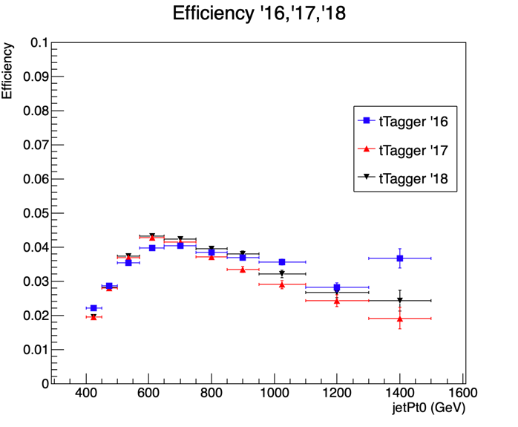
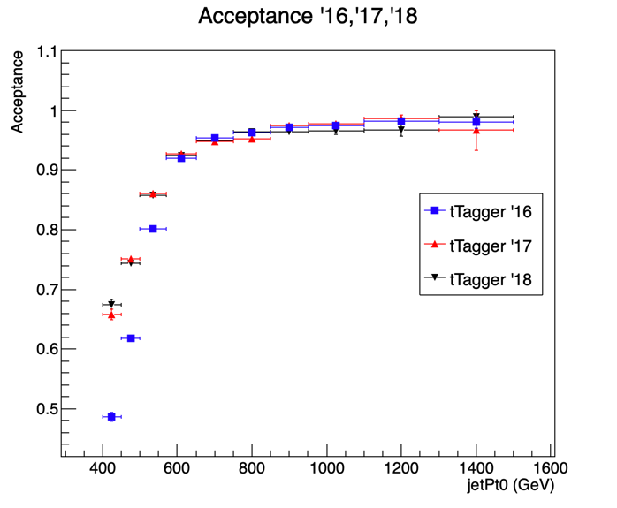
Status full RunII Data
New “top Tagger” that discriminates top jet candidates and QCD multijet background jets
The new tagger is trained per jet and not per event
3 separate trainings for each year (2016, 2017, 2018)
Efficiencies and acceptances for all variables for the 3 separate years
We have decided on 3 different Working Points for our tagger in order for the Efficiency of the leading jet P_{T} to be similar in all 3 years
Response matrices for all variables and for every year accordingly
In agreement with other analysis as well as unknown CSVv2 Working Points for the 2018 MC , we are using the deepCSV b-tagger and not the CSVv2
QCD closure tests
Shape comparison between signal and control region
Data driven method to estimate the QCD bkg shape
Efficiency and Acceptance comparison for ‘16, ‘17, ‘18

Slide 5
Summary
Finalize as soon as possible the 2016 publication (TOP-18-013)
Full RunII analysis
Person power: 2 PhD students and 2 faculty members
Expand the 2016 analysis by adding more variables, attempt BSM constraints within the EFT framework (Effective Field Theory) and double differential cross section measurements
Timescale: End of 2020/ Winter Conference 2021
Significance Progress on software infrastructure and critical analysis tools (topTagger)
We plan to report regularly in forecoming ttX meetings

